Slide 1
Team 12: Quadruped Robot for Smart Agriculture
Team: Austin Neff, Kevin Nelson, Jordan Raver, Ben Seisser, Sam Spencer, Yang Yang
Team Advisors: Shad Roundy, Kam Leang

Slide 2
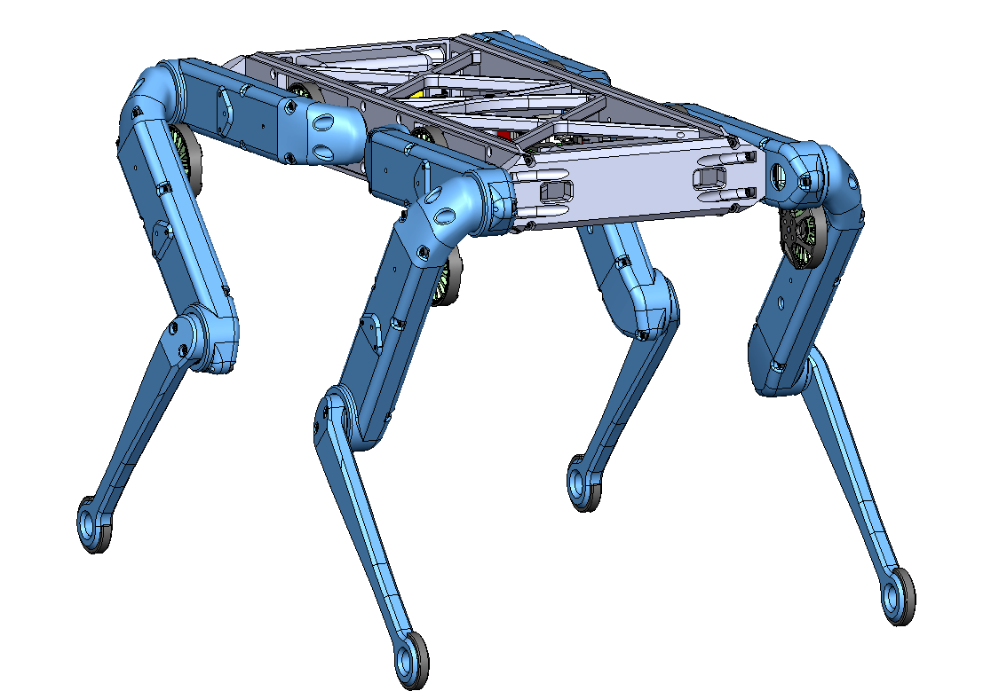
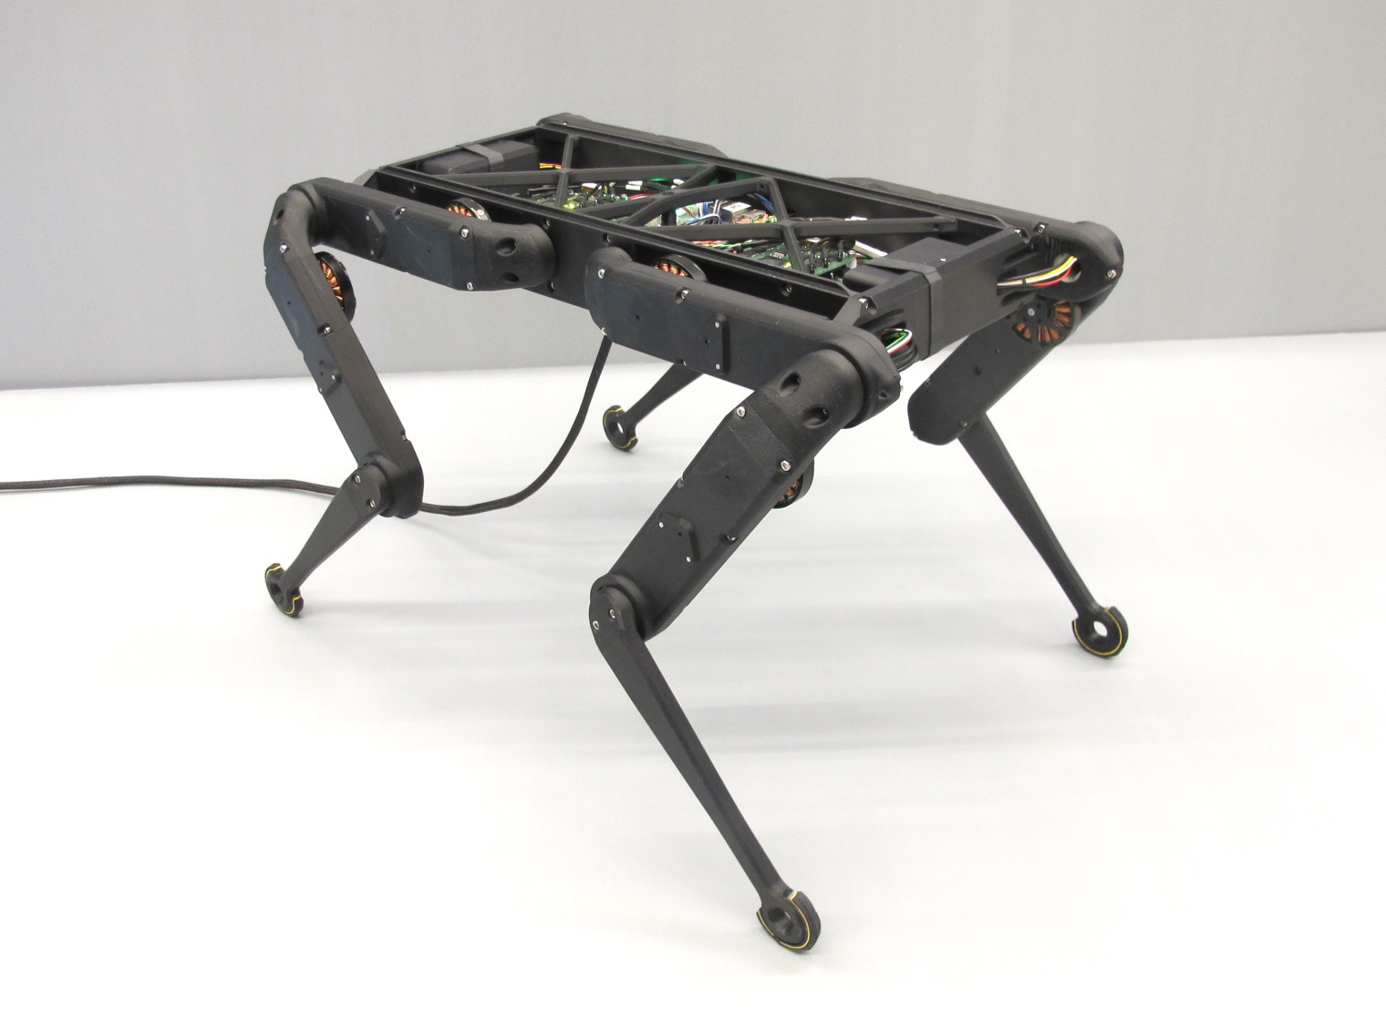
Project Objective
The objective of the project is to construct a quadruped robot. The Open Dynamic Robot Initiative will be used as a base. The robot is intended as a cheaper alternative for robot smart agriculture than what is currently available in professors Roundy and Leang’s laboratories.

Slide 3
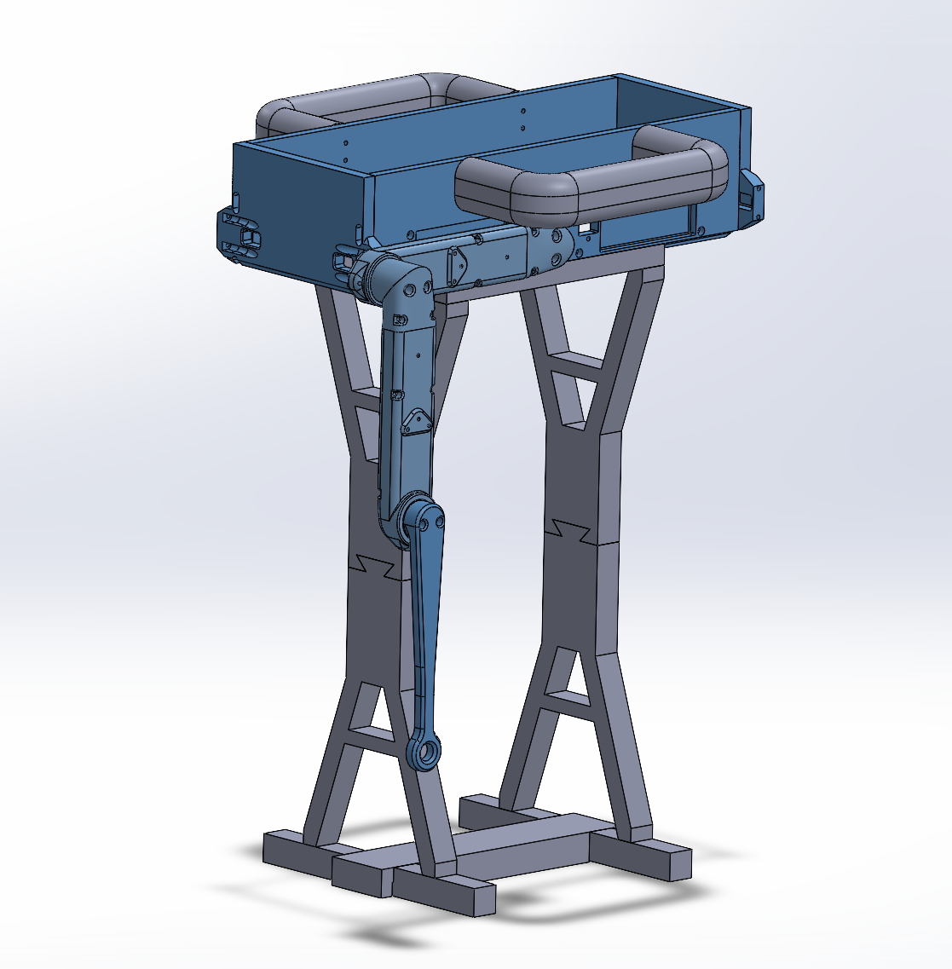
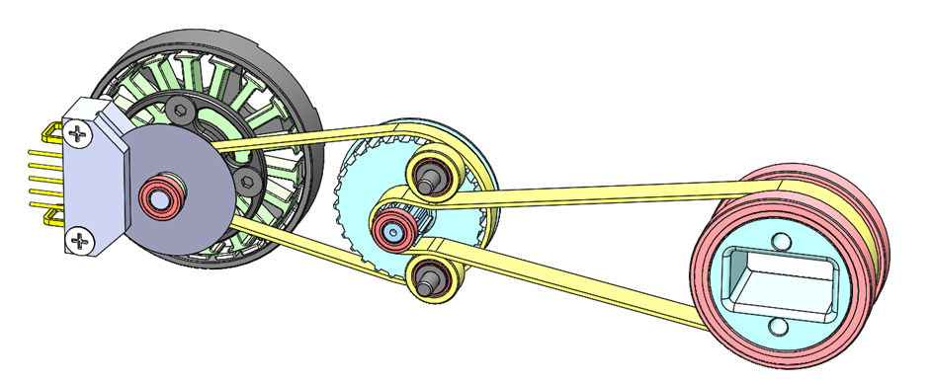
Design Concept
Motor/encoder assembly
Critical component is the motor and encoder assembly.
Must be able to write motor position according to IMU input
Testable using a single assembly + test stand
Results will inform both the coding and the power system requirements

Slide 4
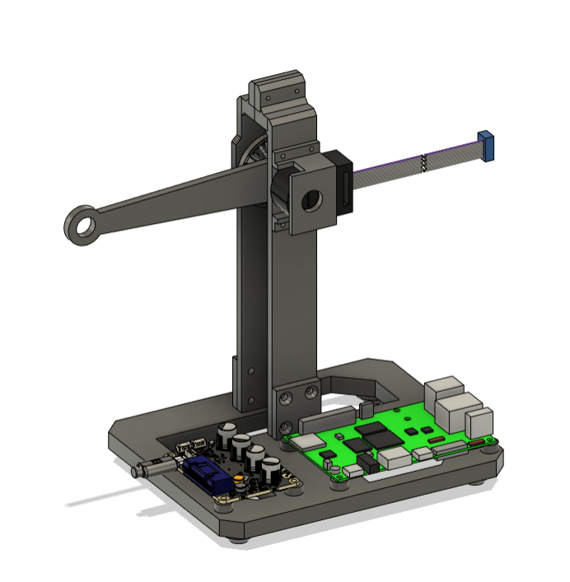
Proof-of-Concept Test Plan
Build a test stand to control one motor from one driver with the Orange Pi 5
Determine target position according to IMU inputs
Improve control parameters to ensure smooth motion

Slide 5
Proof-of-Concept Test Plan
Design Specification | Test Specification | Success
Response Accuracy | Position Control Resolution | <0.1°
Runtime | Power Draw | <100 W
Response Time | Delay between IMU motion and motor motion | <10 ms/degree
Response Time | CPU Load | <12%
Response Time | Total data transfer rate on CAN bus | <1 mbps
Durability | Stall torque (at end of gearing) | >3.35 ft lb

Slide 6
Proof-of-Concept Testing Progress
Experimental Test Plan
Design of the test stand will be created in CAD.
Test stand will be printed and assembled.
The Orange Pi must be configured with Ubuntu, ROS2, CAN enabled, etc.
The driver must be configured with motor specs, limits, control parameters, and CAN communication.
Wiring must be prepared and installed.
Code must be written which reads the I/O pins of the IMU, selects the motor driver address on the CAN bus and writes a desired position to the motor driver.
Using the written code, the positional accuracy, power draw, response time, CPU usage, no load speed, and stall torque will be measured with hand tools, high speed video, and software tools on the Orange Pi.

Slide 7
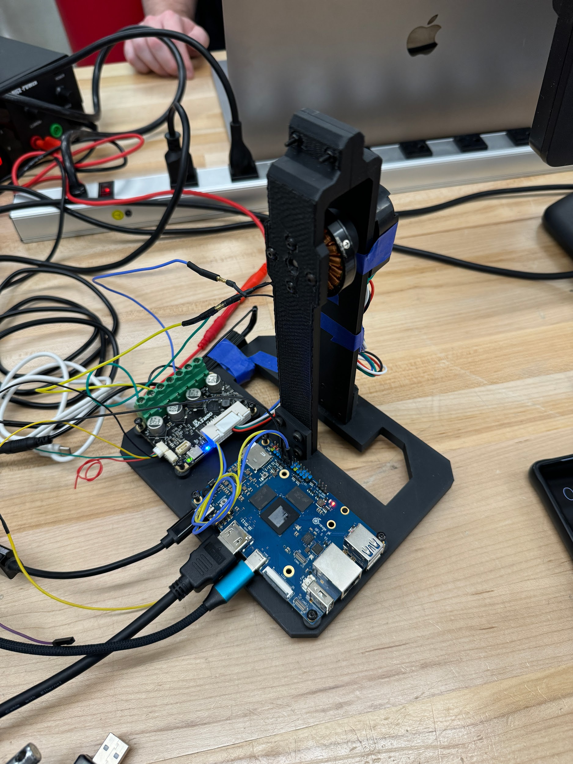
Proof-of-Concept Testing Progress
Results
Affordable ODrive alternative non-functional
CAN, although “built-in” requires a transceiver module
Motor can receive commands from OPi 5
Official ODrive validated for implementation in robot
“Leg” cut short to ensure full rotational range
Unanswered Questions
Is it feasible to chain all drivers on one CAN bus?
Checking the data transmission for one to verify
How big of batteries do we need to meet our runtime expectations?
Verifying power draw during use for one motor will help build estimates

Slide 8
Technical Issues
Test stand calibration issues
Encoder wheel mismatch
Actual encoders have arrived, will be testing on those
Coding in progress
Currently ironing out bugs before testing can begin
ODrive successfully flashed
CAN bus has no native transceiving capabilities
Additional part required

Slide 9
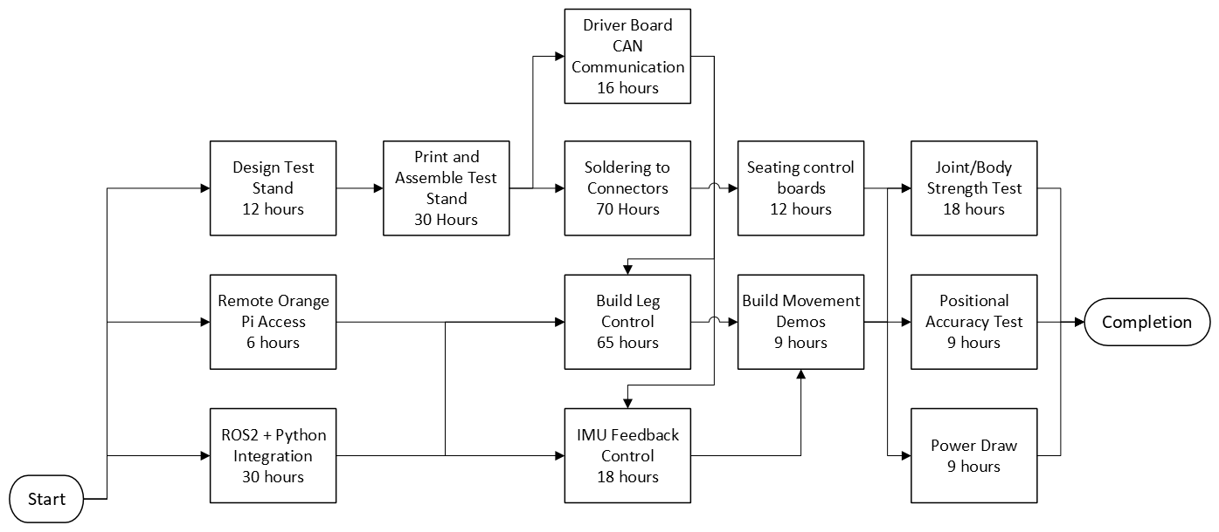
Plans

Slide 10
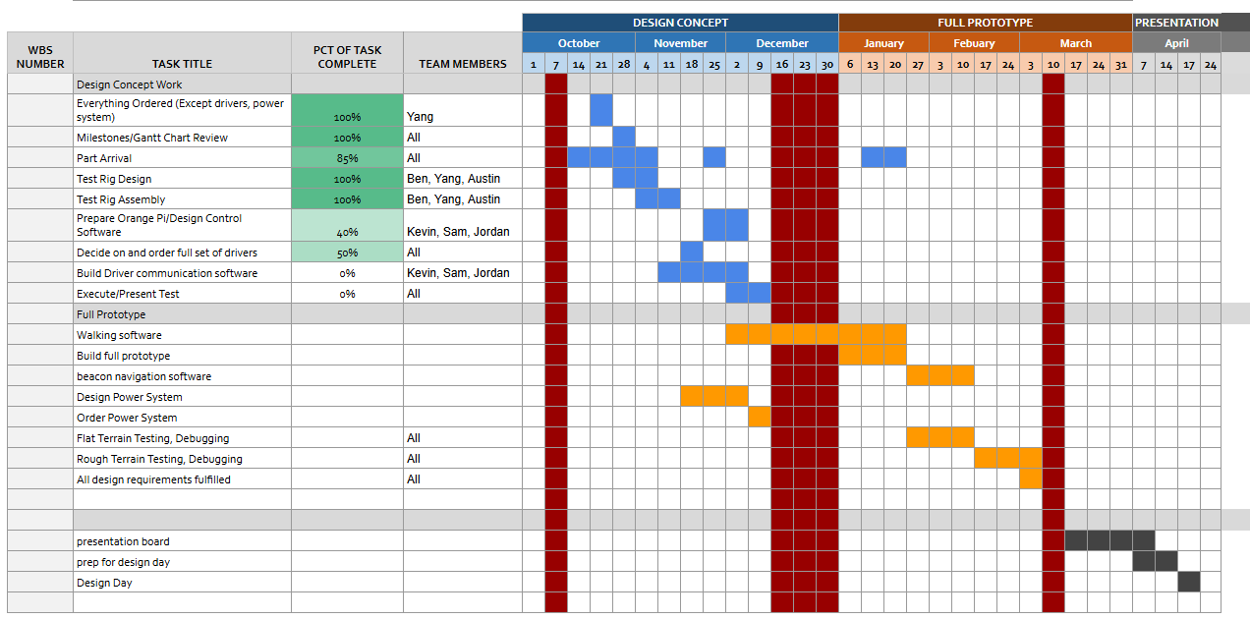
Plans

Slide 11
Ordering Totals:
Total Ordering Information from Purchasing Request Site
Vendor | Date | Subtotal
PWB Encoders | 9/21 | $1,245.77
Amazon | 9/28 | $134.74
Amazon | 9/30 | $9.99
123 Bearing | 9/30 | $382.61
Belting Online | 9/30 | $202.61
McMaster-Carr | 9/30 | $76.10
Amazon | 9/30 | $7.99
Digikey (Returned) | 9/30 | $14.49
Amazon | 10/10 | $127.99
ODrive | 10/21 | $156.61
Bambu Lab | 10/21 | $69.98
Adafruit | 10/21 | $21.33
Digikey | 10/21 | $93.15
Amazon | 10/21 | $119.80
Amazon (Transceivers) | 11/11 | $19.98
ODrive (Servo Control Boards) | 11/11 | 1,050.61
As of 11/11 | Total (+tax&ship): | $3,733.75
All but power system ordered
Still waiting for full set of ODrive boards, CAN transceiver
Final Cost Estimate w/ Untethered Power
w/ Power System Budget of | $1,000
w/ ODrive Controllers |  | $4,733.75

